Slide 1
What Does it Take to Win at Baseball?
Statistics Correlated With Winning Teams
Nick Herman
Python Data Analysis Project 06/09/2023

Slide 2
Background
In the US professional baseball plays more games than any other sport–twice as many as basketball or hockey and ten times more than football.
Because the action is much slower in baseball than in other sports, the fans pay a lot of attention to individual player’s and team’s statistics while watching the games in an effort to better predict what is likely to happen next.
A team’s success can either be measured by their percentage of winning outcomes, or by their ability to win important games such as playoffs. In this analysis, we will look at what contributes to teams being able to win regular season games.

Slide 3
Why Should This be Studied?
Coaches can use this information to determine what to focus on during practices
Recruiters could know which statistics to look for in new players, and what would be most beneficial to winning. Could also help determine the value of a contract.
Players can study their performance and work to emulate others who succeed in the important categories.
Fans spend time and money following baseball blogs and teams and having more insight helps them feel more connected.
Gamblers could learn from historical data to best predict future outcomes.
Notes:
Outside of North/Central America, baseball is not a popular sport. Even in the U.S.A. Football and Basketball are much more nationally beloved and followed by the public.
The insights from this project have 2 real possible uses: for organizations to determine how to focus their recruitment efforts, and for curious fans to see how teams perform and how what is important has changed over the years.
Professional baseball analysts call the study of their statistics sabermetrics. The man who coined this term in 1980, says it is “the search for objective knowledge about baseball.” They use the same database I did as well as others with more specific information.

Slide 4
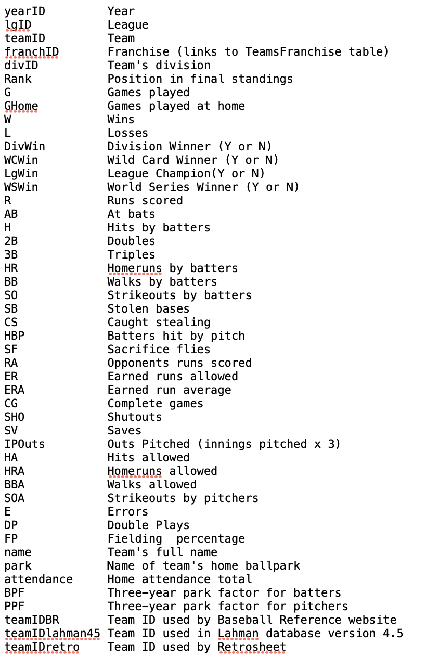
The Data
Lahman Baseball Database (Teams Table)
http://seanlahman.com/download-baseball-database/
The teams table I analyzed gives the record of each team for every year the sport has been played professionally.
This information is for regular season games only and doesn’t measure playoff performance.
The columns from the table are statistics based on team performance, and each row is a single team for a specified year.

Slide 5
Data Cleaning Steps
Additional columns
['R', 'AB', 'H', '2B', '3B', 'HR', 'BB', 'SO', 'SB', 'CS', 'HBP', 'SF', 'RA', 'ER', 'HA', 'HRA', 'BBA', 'SOA', 'E', 'DP', R_Diff] - All converted into per game instead of per season.
Average Attendance added but only calculated by home games
OBP, SLG, W%, BA, Run Differential added
OBP = (H+BB+HBP) / (AB+BB+HBP+SF)
SLG = (H+2B+2*3B+3*HR) / AB
W% = W / (W+L)
BA = H/AB (AB!=SF,BB,HBP)
R_Diff = R-RA
Missing Data
For OBP: no HBP before 1884, no SF data before 1970 and thus set to 0 instead of Nan
For attendance, no consistent data prior to 1891, (also missing some 1914/15) and thus was set to 0 instead of Nan

Slide 6
Data Refinement: Eras in the game
Pre-1900: 1871-1900
Prior to 1900 the rules of the game were not consistent across all the teams. There were more leagues than there are today and while statistics were kept, they are highly erratic and don’t align with those after 1900, when “modern baseball” began to be played.
Dead Ball Era: 1900-1920
During this stage of the games, the stadiums were larger, and the baseball itself was designed in such a way to purposely limit hitting ability. Reusing the same ball repeatedly also led to a decrease in its aerodynamics. Finally, during this period, the pitchers were allowed to scuff/alter the ball before they threw it to give them even more of an advantage. There are the least runs and home runs per game during this era.
Modern Era/Live Ball Era: 1920-Present
Golden Age: 1920-1960
Dominated by the New York Yankees, who were best in their division 29 times and won 20 World Series titles between 1918 and 1964.
Steroid Age: Roughly 1985 - 2004
Steroids began to enter baseball in the late 1980s, and by 1994 had spread throughout the league.

Slide 7
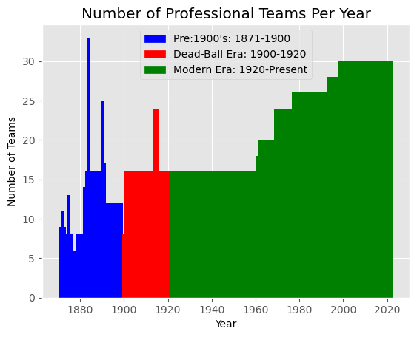
League Expansion
Originally, there were many professional teams and many leagues all competing for the public’s interest.
By 1903 the American and National Leagues were the most relevant ones.
They unified and the World Series was created to determine the true best team of the year.

Slide 8
Research Question s
What factors are most highly correlated with winning outcomes?
Is there a certain level of success required in each of these stats or is it relative to the other teams performance for the given year?
What are the differences between offensive (batting) statistics and defensive (pitching and fielding) statistics, and which play more of a role in team success?

Slide 9
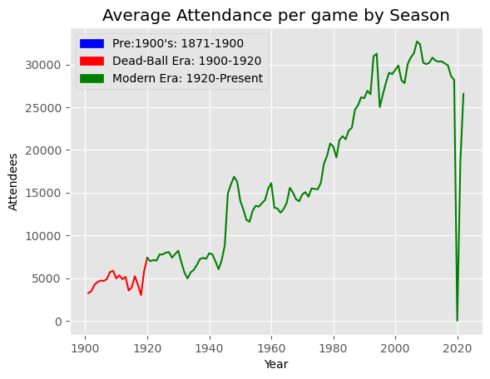
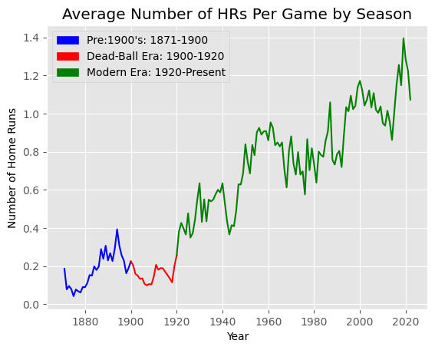
Assumptions
Two of the factors I thought would be most associated with teams winning a lot of games were the number of home runs hit and the average attendance at the games.
Note: No attendance data prior to 1900 and no attendance permitted in 2020 due to COVID-19
Notes:
While both of these figures have increased steadily over the years, neither was correlated with winning percentage

Slide 10
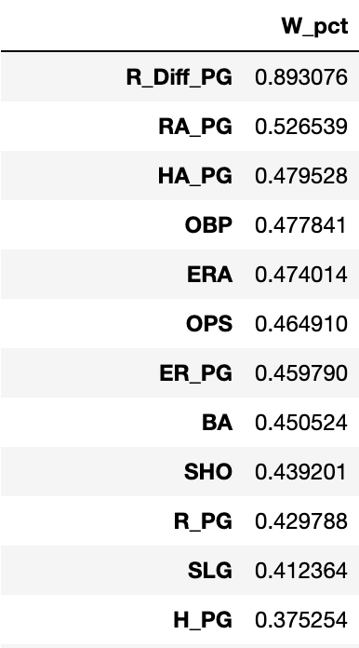
Factors Most Correlated With Winning
Checking correlation using the pandas DataFrame.corr() function both for the entire dataframe as well as for the individual Eras and sub Eras, I found which factors were the most highly correlated with winning percentage.

Slide 11
Analyzing the Data
Here is a comparison of the different columns in order of correlation to winning percentage
The distribution of winning percentage is much more spread out as factors become less and less correlated

Slide 12
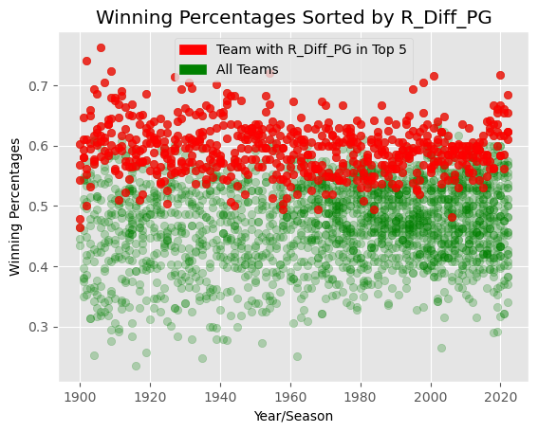
Top Correlation- Run Differential
Run differential measures on average how many more runs per game a team scores than their opponent.
It is clear that the teams who outscore their opponents by the largest margins tend to win the most games
Run Differential is based on success in both offensive and defensive data
Notes:
The most highly correlated column was run differential per game. Baseball games cannot end in ties (aside for some very rare circumstances) so it makes sense that the in order to be successful you need to outscore your opponents. However, since this

Slide 13


Breaking Down the Data
Offensive
Defensive

Slide 14
Offensive Factors Most Correlated With Winning
On-Base Percentage (OBP)
How frequently a player is successful at getting on base by any means
On-Base Plus Slugging (OPS)
Representation of a players skill both at getting on base and hitting for power, arguably the two most important offensive skills
Batting Average (BA)
The ratio of a players hits to at-bats
Runs Scored Per Game (R_PG)
Average number of runs a team scores in each game
Slugging Percentage (SLG)
How productive a players hits are. Hits for extra bases are weighed more heavily
Hits Per Game (H_PG)
Average number of hits a team records in each game

Slide 15
Offensive Factors Most Correlated With Winning
On-Base Percentage (OBP)
How frequently a player is successful at getting on base by any means
On-Base Plus Slugging (OPS)
Representation of a players skill both at getting on base and hitting for power, arguably the two most important offensive skills. This is calculated by adding OBP + SLG
Batting Average (BA)
The ratio of a players hits to at-bats
Runs Scored Per Game (R_PG)
Average number of runs a team scores in each game
Slugging Percentage (SLG)
How productive a players hits are. Hits for extra bases are weighed more heavily
Hits Per Game (H_PG)
Average number of hits a team records in each game

Slide 16
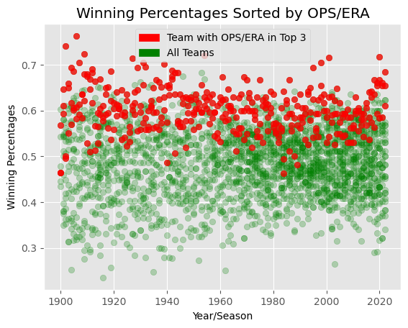

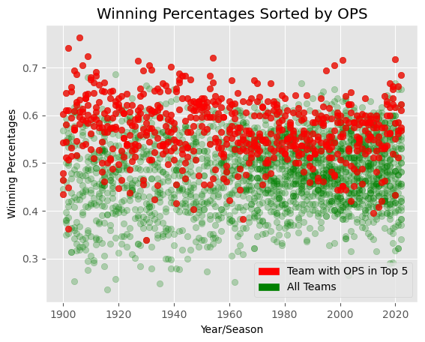
On-Base Plus Slugging (OPS)

Slide 17
On-Base Plus Slugging (OPS)

Slide 18
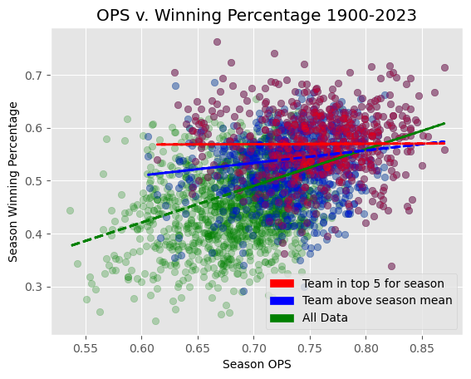
On-Base Plus Slugging (OPS)

Slide 19
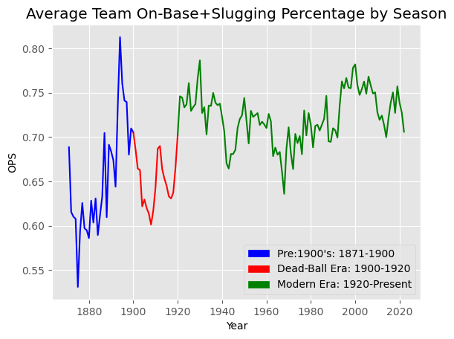
On-Base Plus Slugging (OPS)

Slide 20
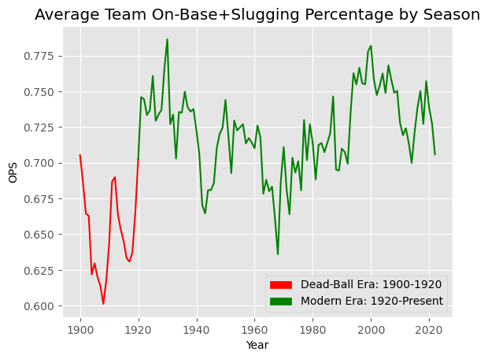
On-Base Plus Slugging (OPS)
Because they
Changed game
To keep fans interested

Slide 21
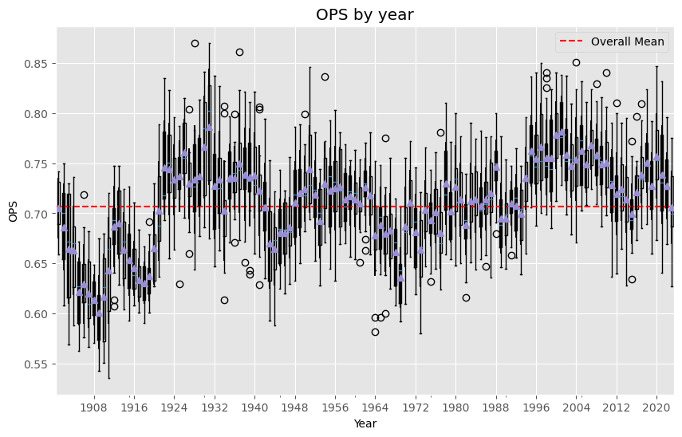
On-Base Plus Slugging (OPS)

Slide 22
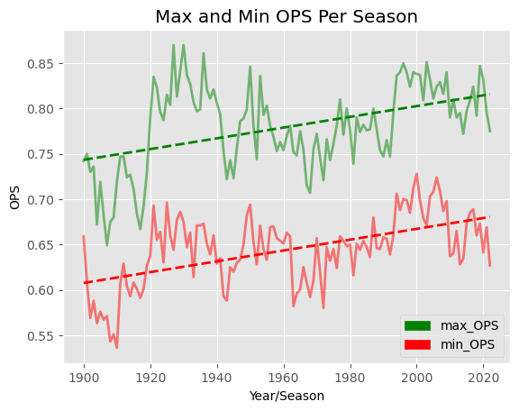
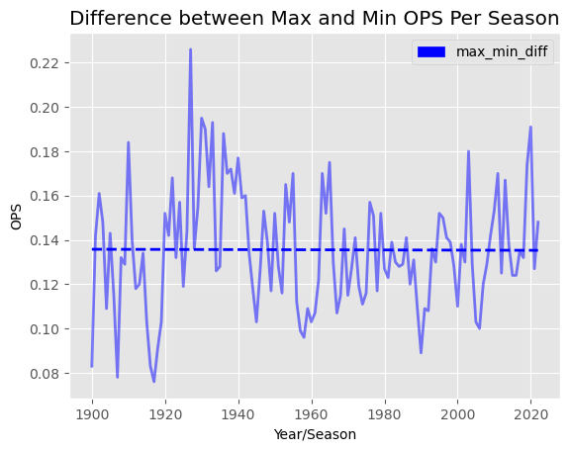
On-Base Plus Slugging (OPS)

Slide 23
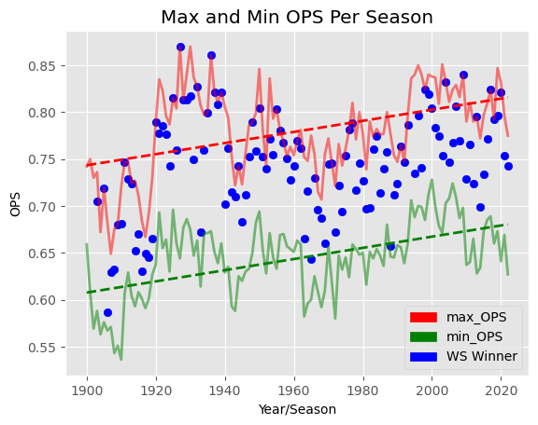
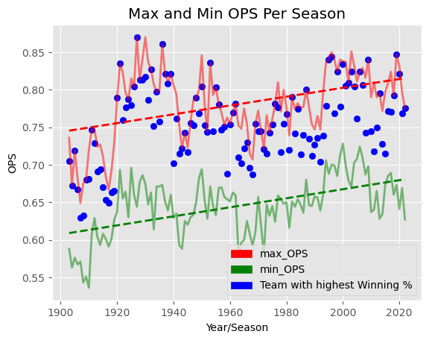
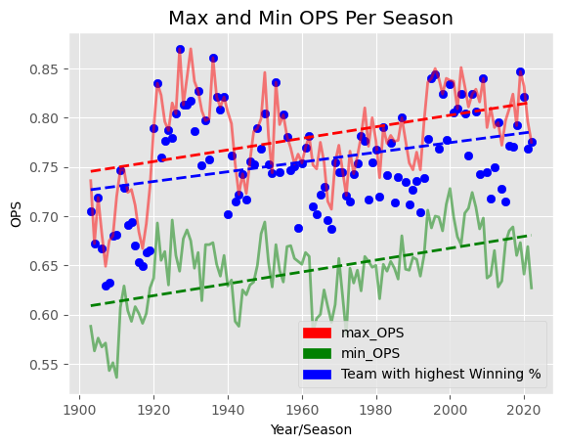
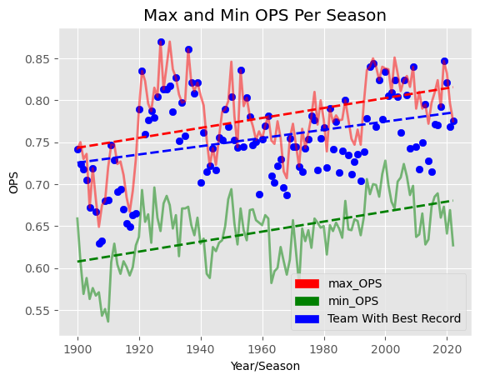
On-Base Plus Slugging (OPS)

Slide 24
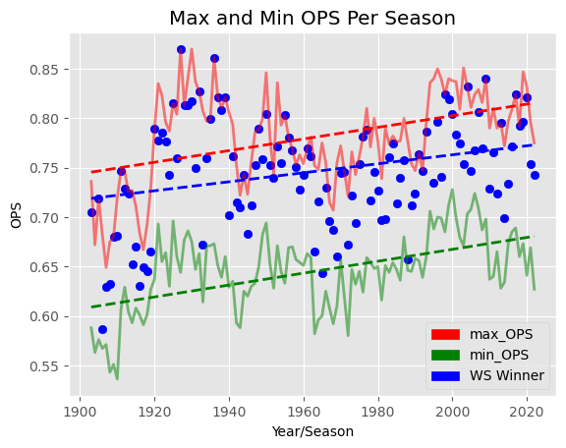
On-Base Plus Slugging (OPS)

Slide 25
Defensive Factors Most Correlated With Winning
Runs Allowed Per Game (RA_PG)
The average number of runs a team lets their opponent score in each game
Hits Allowed Per Game (HA_PG)
The average number of times a team lets their opponent hit in each game
Earned Run Average (ERA)
The average number of runs a team gives up per 9 innings. It is a measurement of the runs they allowed to score excluding those caused by errors.
Earned Runs Allowed Per Game (ER_PG)
The number of runs a team allows per game excluding those caused by errors.
This is a very similar statistic to the above and has a similar correlation
Shutouts (SHO)
How many times per season a team prevents their opponents from scoring any runs

Slide 26
Defensive Factors Most Correlated With Winning
Runs Allowed Per Game (RA_PG)
The average number of runs a team lets their opponent score in each game
Hits Allowed Per Game (HA_PG)
The average number of times a team lets their opponent hit in each game
Earned Run Average (ERA)
The average number of runs a team gives up per 9 innings. It is a measurement of the runs they allowed to score excluding those caused by errors.
Earned Runs Allowed Per Game (ER_PG)
The number of runs a team allows per game excluding those caused by errors.
This is a very similar statistic to the above and has a similar correlation
Shutouts (SHO)
How many times per season a team prevents their opponents from scoring any runs

Slide 27
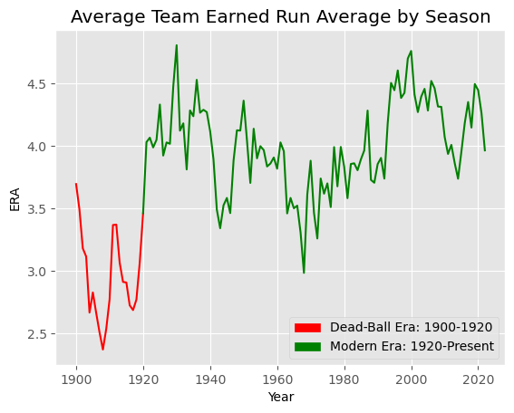
Earned Run Average (ERA)

Slide 28
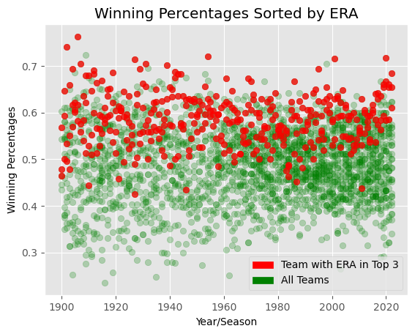
Earned Run Average (ERA)

Slide 29
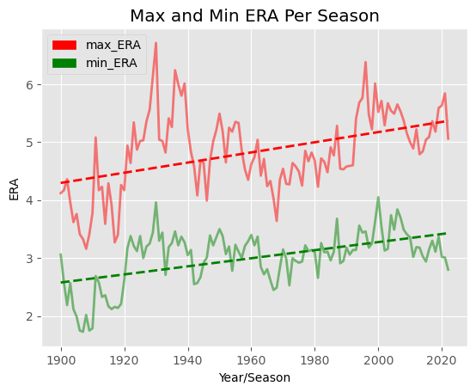
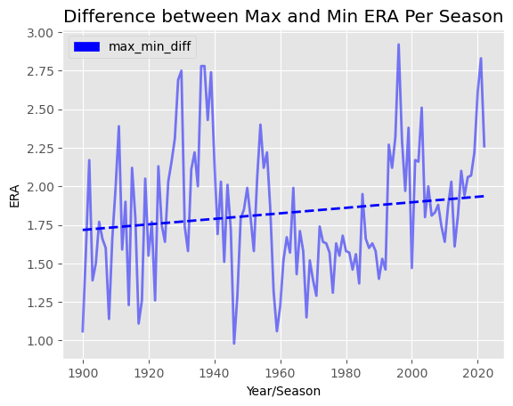
Earned Run Average (ERA)

Slide 30
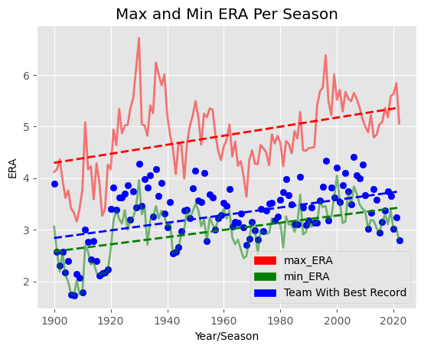
Earned Run Average (ERA)

Slide 31
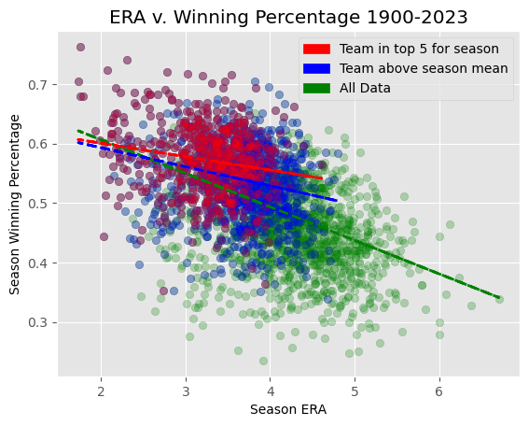
Earned Run Average (ERA)

Slide 32
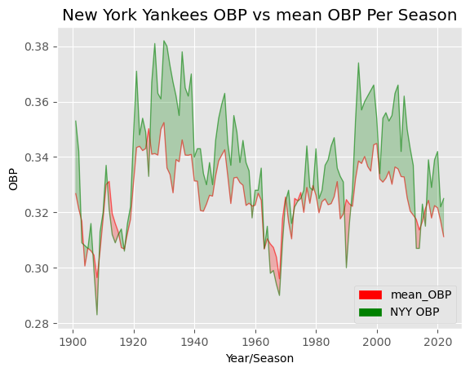
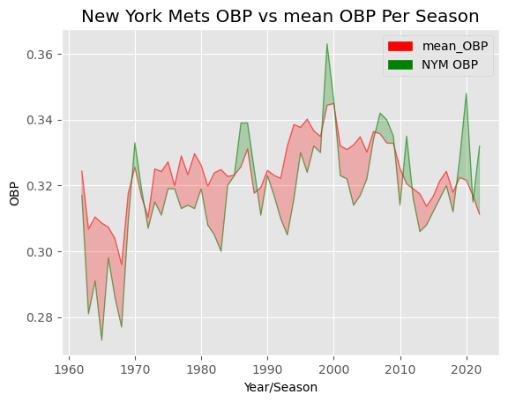
Future Work
I started to analyze specific teams. Trying to figure out why the Mets frequently lose and the Yankees seem to always win.

Slide 33
Future Work
If I had more time I would do more in depth analysis on individual teams and then specific players to see who makes the greatest contribution.
Teams always have more players than they use on a given day, and the lineups could be optimized to give them the best chance to win. It could also give teams insights on who they should trade for or who they can afford to give up.
With more time and data I would see which was more beneficial: for a team to add a specific player who excelled in a specific statistic or focus on bringing up their averages in these important statistics. A budget has to be allotted and if it all goes to a “super star” could it be worth it?

Slide 34
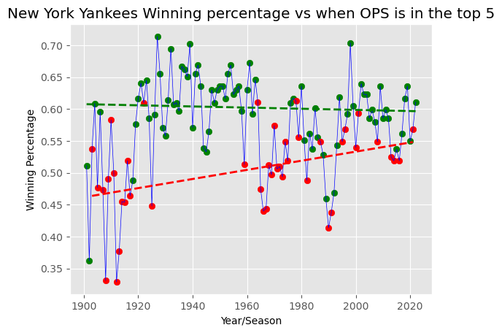
Future Work

Slide 35
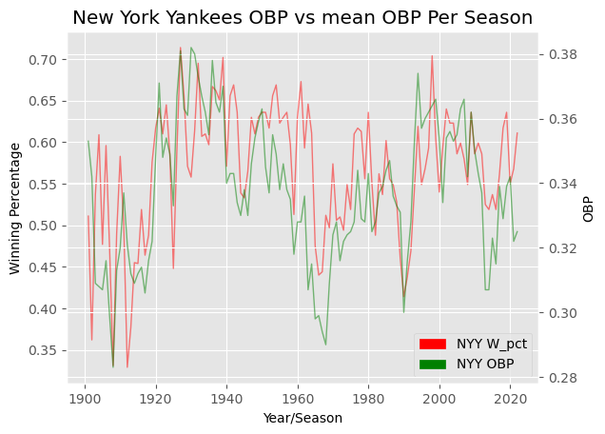
Future Work

